Slide 1

Bank Analytics
GROUP – 6
MR. VINAY DINESH WANKHADE
MR. JANNU NEERAJ ARMSTRONG
MISS.AKSHATA SANJAY PAWAR
MISS. SANAA SHAIKH
MR. AAVULA ADITYA YADAV
MR. NILESH NAMDEV RATHOD
MR. A RAGHAVENDRA KUMAR

Slide 2
INTRODUCTION OF BANK ANALYSIS
Bank analysis refers to the process of evaluating and assessing the financial health, performance, and risk profile of a bank or a financial institution. It involves examining various aspects of a bank's operations, including its balance sheet, income statement, cash flow statement, risk management practices, regulatory compliance, and overall strategy.
Key Components of Bank Analysis: Financial Statements, Asset Quality, Capital Adequacy, RISK MANAGEMENT, Regulatory Environment, Market and Competitive Analysis.

Slide 3
Bank Analytics KPI’S
YEAR WISE LOAN AMOUNT STATS
GRADE AND SUB GRADEWISE REVOL_BAL
TOTAL PAYMENT FOR VERIFIED STATUS VS TOTAL PAYMENT FOR NON VERIFIED STATUS
STATE WISE AND MONTH WISE LOAN STATUS
HOME OWNERSHIP VS LAST PAYMENTY DATE STATUS.

Slide 4
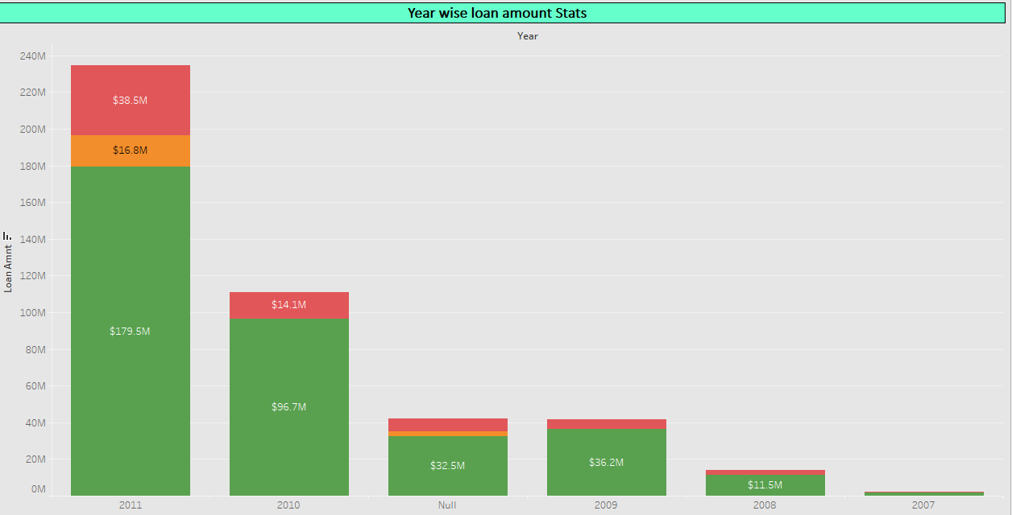
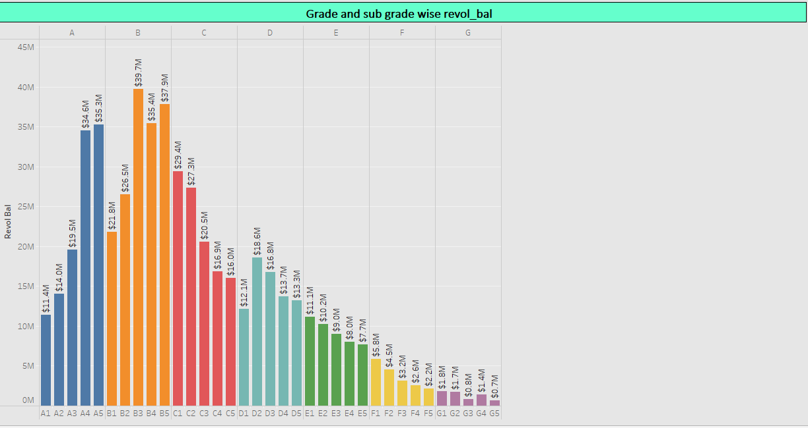
Bank Analytics KPI’S
YEAR WISE LOAN AMOUNT STATUS: By analyzing these factors year-wise, you can gain valuable insights into the bank's loan amount status, identify trends, and assess the overall health of its loan portfolio. This information is crucial for stakeholders such as investors, regulators, and bank management to make informed decisions regarding risk management, capital allocation, and strategic planning.
GRADE AND SUB GRADEWISE REVOL_BAL: By conducting this analysis, stakeholders can gain valuable insights into the distribution and behavior of revolving balances across different credit grades and sub-grades. These insights can inform credit risk management strategies, pricing decisions, and portfolio optimization efforts within the lending institution.

Slide 5
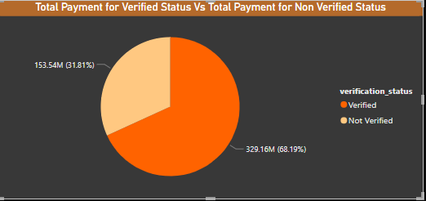
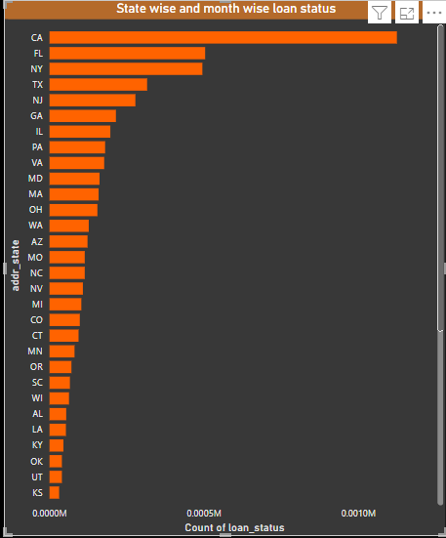
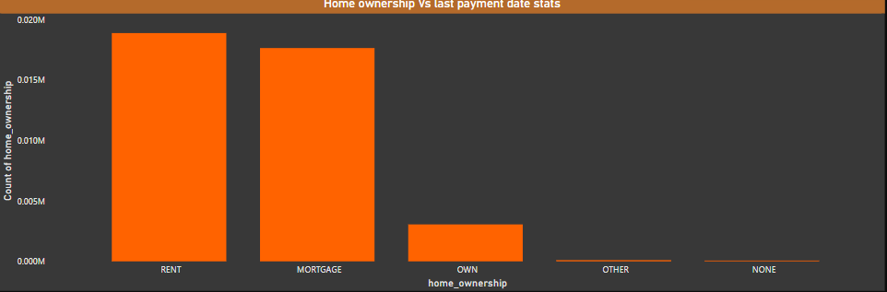
TOTAL PAYMENT FOR VERIFIED STATUS VS TOTAL PAYMENT FOR NON VERIFIED STATUS: Insights from this analysis can help lending institutions understand the impact of borrower verification status on payment behavior and overall portfolio performance. It can also inform risk management strategies, underwriting criteria, and verification processes to mitigate credit risk and improve loan portfolio quality.
STATE WISE AND MONTH WISE LOAN STATUS: By conducting state-wise and month-wise analysis of loan status, lending institutions can gain a deeper understanding of regional and temporal variations in loan performance, enabling them to make more informed decisions and manage credit risk more effectively.
HOME OWNERSHIP VS LAST PAYMENTY DATE STATUS: By conducting this analysis, lending institutions can gain a deeper understanding of the relationship between home ownership status and last payment date status, enabling them to better assess credit risk, make informed lending decisions, and develop

Slide 6
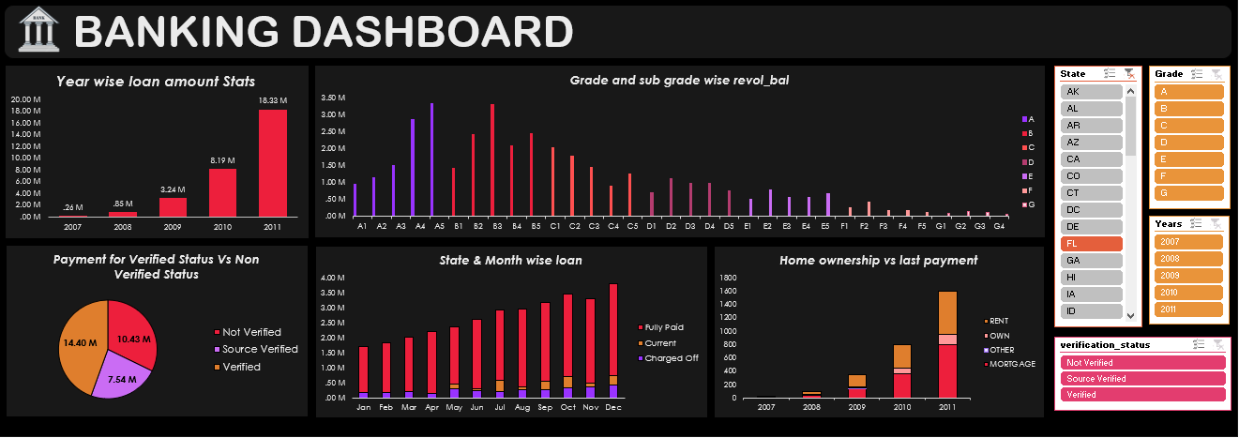
EXCEL DASHBOARD

Slide 7
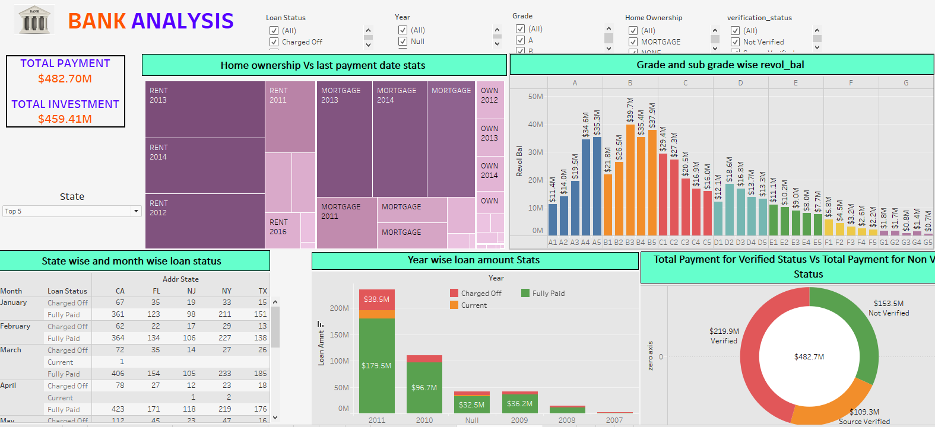
TABLEAU DASHBOARD

Slide 8
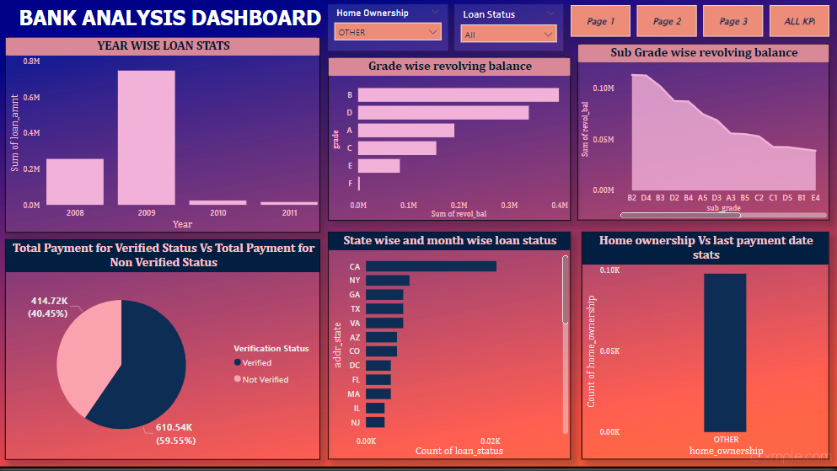
POWER BI DASHBOARD

Slide 9
CONCLUSION
In conclusion, the bank loan analysis provides a comprehensive overview of the bank's financial health, risk profile, and competitive position. It enables stakeholders to make informed decisions regarding investment, regulation, risk management, and strategic planning to ensure the bank's long-term success and sustainability in the dynamic banking industry.
the bank analysis underscores the bank's solid financial foundation, effective risk management practices, and competitive positioning in the market. By leveraging strengths and addressing areas for improvement, the bank can navigate challenges and capitalize on opportunities to achieve long-term success and value creation for stakeholders

Slide 10
THANK YOU ……..

